Slide 1
Faithfully Serving the Lord
Acts 20:17-36

Slide 2
Big Idea
Faithfulness in serving the Lord is the single most significant quality of a believer

Slide 3
Faithful
Revelation 2:10 --- Do not fear what you are about to suffer. Behold, the devil is about to cast some of you into prison, so that you will be tested, and you will have tribulation for ten days. Be faithful until death, and I will give you the crown of life.
Matthew 25:21--- His master said to him, 'Well done, good and faithful slave. You were faithful with a few things, I will put you in charge of many things; enter into the joy of your master.'

Slide 4
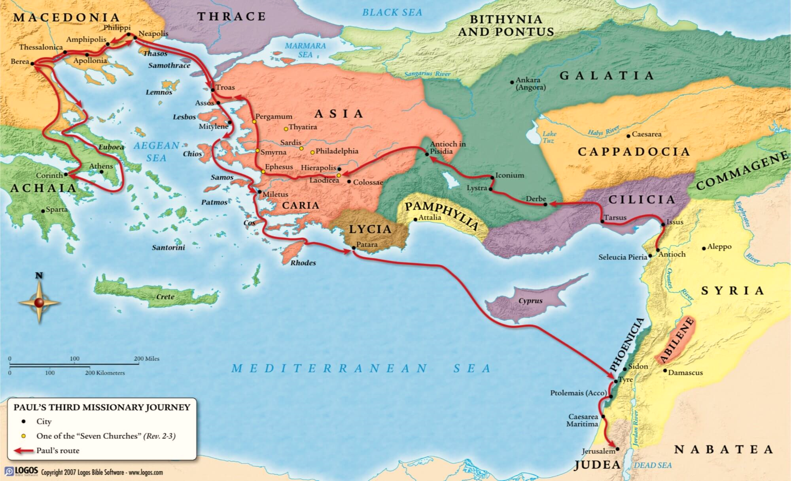
Faithful
Revelation 2:10 --- Do not fear what you are about to suffer. Behold, the devil is about to cast some of you into prison, so that you will be tested, and you will have tribulation for ten days. Be faithful until death, and I will give you the crown of life.
Matthew 25:21--- His master said to him, 'Well done, good and faithful slave. You were faithful with a few things, I will put you in charge of many things; enter into the joy of your master.'

Slide 5
To what are we to be ultimately faithful?
Faithful to the Lord

Slide 6
Philippians 3:8
“More than that, I count all things to be loss in view of the surpassing value of knowing Christ Jesus my Lord, for whom I have suffered the loss of all things, and count them but rubbish so that I may gain Christ…”

Slide 7
Question
Am I more faithful to the Lord…
…or to myself?

Slide 8
To what are we to be ultimately faithful?
Faithful to the Lord
Faithful to God-given roles

Slide 9
How Paul served
Teaching (v. 20) - teaching you publicly and from house to house
Testifying of Christ (v. 21) - solemnly testifying to both Jews and Greeks of repentance toward God and faith in our Lord Jesus Christ.
Preaching (v. 25) - I went about preaching the kingdom…
Admonishing (v. 31) - I did not cease to admonish each one with tears.

Slide 10
Revelation 2:2
“I know your deeds and your toil and perseverance, and that you cannot tolerate evil men, and you put to the test those who call themselves apostles, and they are not, and you found them to be false…”

Slide 11
Question
Am I fulfilling my God-given role in His kingdom?

Slide 12
To what are we to be ultimately faithful?
Faithful to the Lord
Faithful to God-given roles
Faithful to the whole purpose [counsel] of God

Slide 13
2 Timothy 3:16
“All Scripture is inspired by God and profitable for teaching, for reproof, for correction, for training in righteousness…”

Slide 14
Question
Am I faithful in learning and obeying the whole purpose of God?

Slide 15
How are we to remain faithful?
Be on guard…

Slide 16
Proverbs 4:23
“Watch over your heart with all diligence,
For from it flow the springs of life.”

Slide 17
1 Timothy 1:18-19; 4:16
1:18 Timothy, my son, I give you this instruction in keeping with the prophecies once made about you, so that by following them you may fight the good fight, 19 holding on to faith and a good conscience. Some have rejected these and so have shipwrecked their faith.
4:16 “Watch your life and doctrine closely. Persevere in them, because if you do, you will save both yourself and your hearers.”

Slide 18
Revelation 2:4
“But I have this against you,
that you have left your first love.”

Slide 19
Question
Have I left my first love? Has my love for the Lord grown cold?

Slide 20
How are we to remain faithful?
Be on guard…
Invest in God’s Word
Depend upon the faithfulness of the Lord to keep you faithful

Slide 21
1 Thessalonians 5:23-24
23 Now may the God of peace Himself sanctify you entirely; and may your spirit and soul and body be preserved complete, without blame at the coming of our Lord Jesus Christ. 24 Faithful is He who calls you, and He also will bring it to pass.

Slide 22
Faithfully Serving the Lord
Acts 20:17-36

